Slide 1
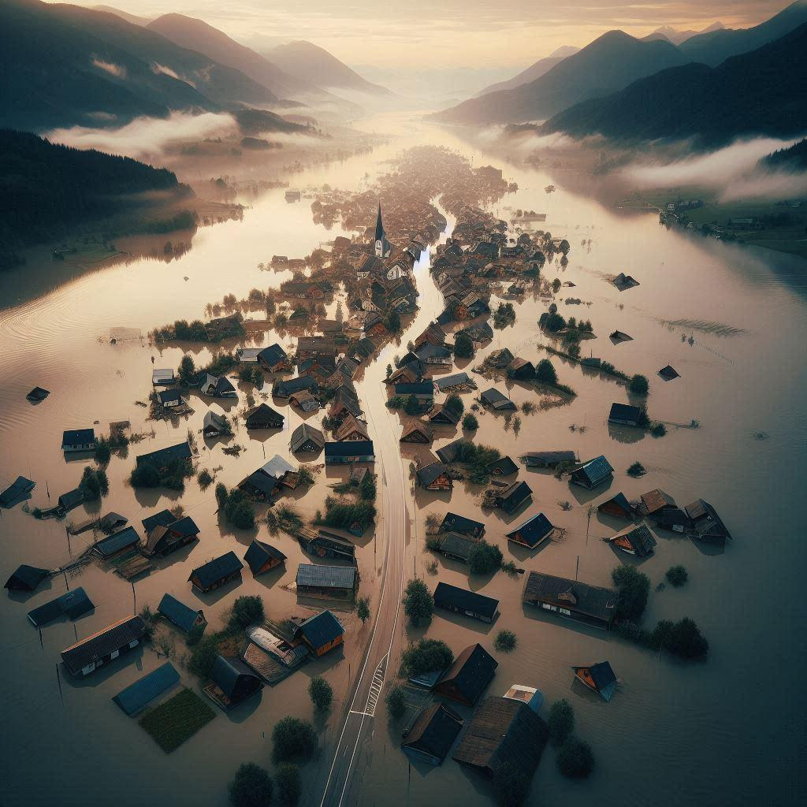


TERRA-
Tracking and Environmental Real-time Response Apparatus
Revolutionizing Flood Management Through Real-Time Data

Slide 2
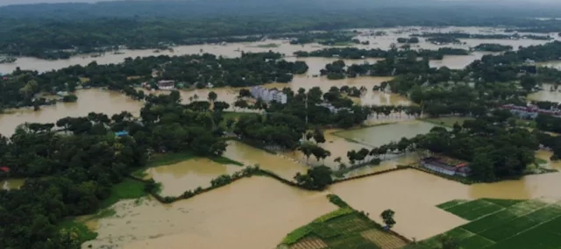

PROBLEM STATEMENT
KEY PROBLEM:
Lives Threatened
Current Solutions Fails because:
Economic Unstability
Infrastructure Damage
Delayed prediction
Unreliable predictions based on only Statistics
Impact:
Poor Resource Allocation
Delayed disaster response

Slide 3

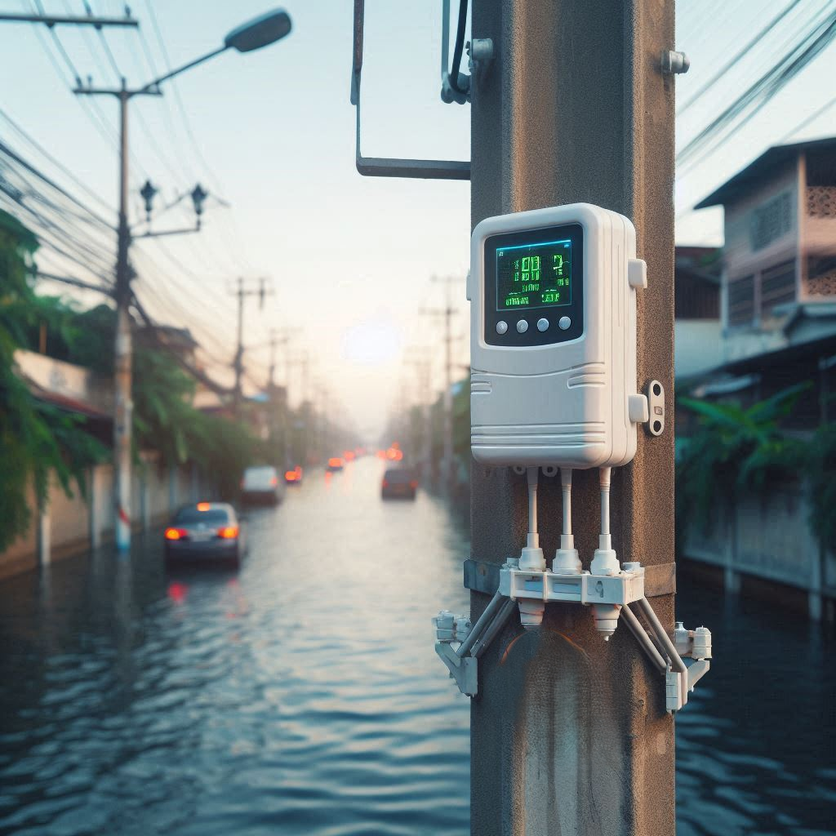



Introducing TERRA
Tracking and Environmental Real-time Response Apparatus
An All in One Digital Disaster management System
TERRA . An automated, real time environment monitoring system. That gathers Critical Flood Data
Water levels,
Humidity,
Temperature
Air quality
Automated and Reliable
No need for citizen reporting, with multiple connectivity options (Wi-Fi, GSM, 4G) to ensure continuous data flow even in remote areas.
Immediate Impact
Provides real-time data for informed decision-making and rapid response.
3

Slide 4
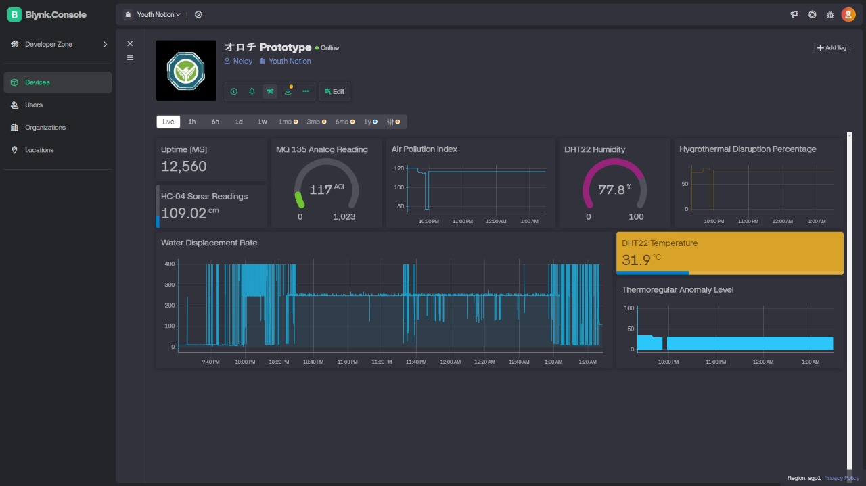
HOW IT WORKS
HARDWARE COMPONENTS:
CONNECTIVITY:
REAL-TIME DATA:
ESP8266, DHT22, MQ135, HC-04, TP4056 BMS, DC-DC boost converter, AC-DC 5V adapter, 18650 battery.
Supports multiple networks and power sources for uninterrupted operation.
Daily updates on water levels, weather, and air quality deliver situational awareness.
4

Slide 5
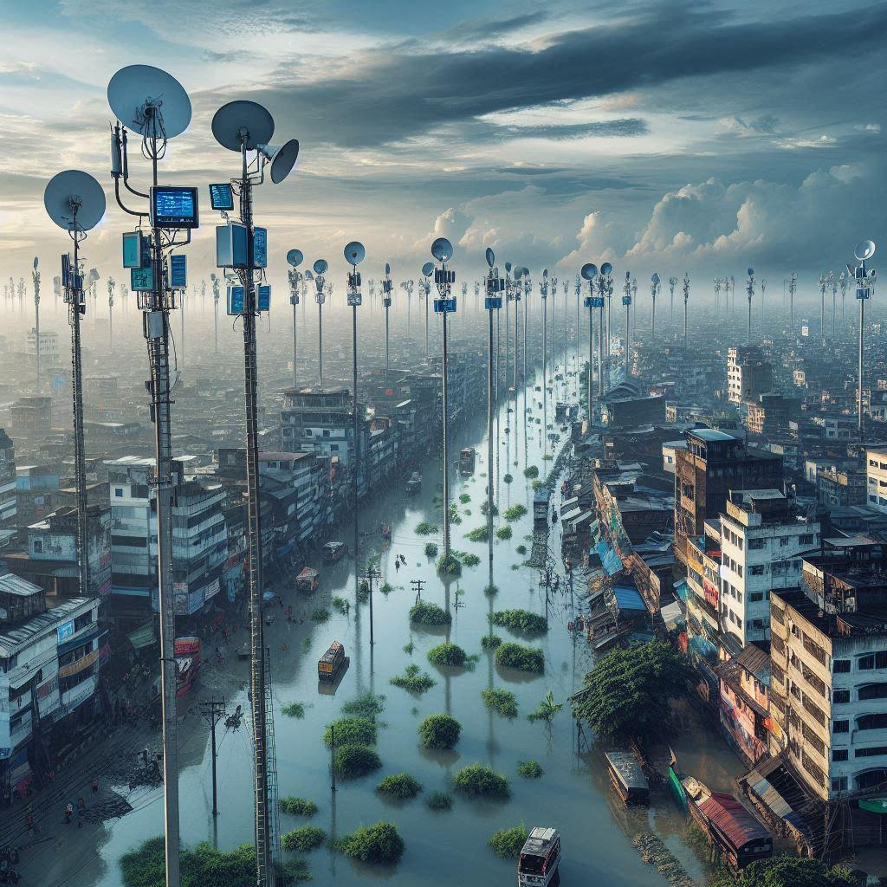
WHY TERRA IS SUPERIOR
Feature | TERRA | Traditional Systems
Real-Time Reporting | ✔ | ✖
Fully Automated | ✔ | ✖
Multi-Connectivity Support | ✔ | ✖
Expanded Situational Data | ✔ | Limited
Scalability | ✔ | ✖
Outcome: Faster, smarter flood response and proactive crisis management.

Slide 6



TARGET MARKET
Government Agencies: Disaster management, environmental agencies
Local Authorities: City corporations and municipal bodies
NGOs & International Organizations: Focused on disaster relief and resilience
Agriculture Sector: Farmers and agricultural bodies
Construction and Real Estate: For property assessments in flood-prone areas
Insurance Companies: Flood risk assessment data.

Slide 7
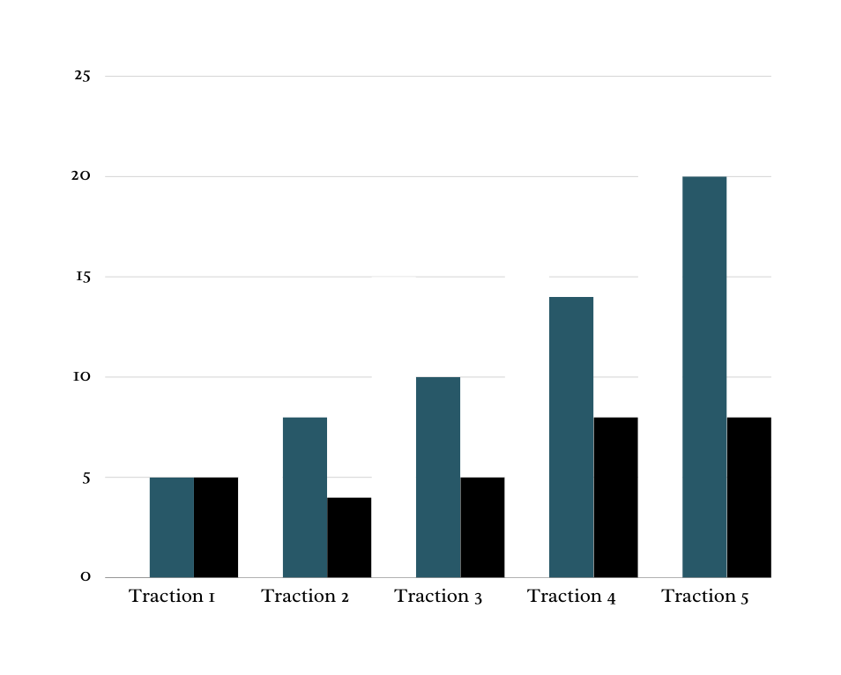

REVENUE MODEL
Government Contracts: Infrastructure planning and environmental data.
Subscription Services: Real-time data for government, local authorities, and private companies.
Environmental Licensing and Testing: Through partnerships with regulatory bodies.
Consultancy and Planning: Data-backed recommendations for flood-prone areas.
Premium Alerts and Data Analytics: For private entities like fishermen, transport companies, and NGOs.
Training and Workshops: Partnerships with NGOs and community organizations for disaster preparedness.
Agriculture Sector : Monitoring flood risks and climate impacts to support crop planning and reduce agricultural loss.

Slide 8
Prototype and Future Development:
Current prototype
Future Expansion
Long-term
Vision
Monitors water level, temperature, humidity, and
air quality in real time.
Additional sensors and predictive models to monitor comprehensive environmental conditions (e.g., soil quality, river levels) for national situational awareness.
Equip policymakers with full environmental data for informed decisions affecting agriculture, disaster response, and economic planning.

Slide 9

Real-Time, Continuous Data
Infrastructure Adaptability:
Real-Time, Continuous Data
Uninterrupted, automated monitoring provides accuracy.
Multi-network support (Wi-Fi, GSM, 4G) and multiple power options to operate in remote, resource-limited areas.
Uninterrupted, automated monitoring provides accuracy.
COMPETITIVE ADVANTAGES OF TERRA
10

Slide 10
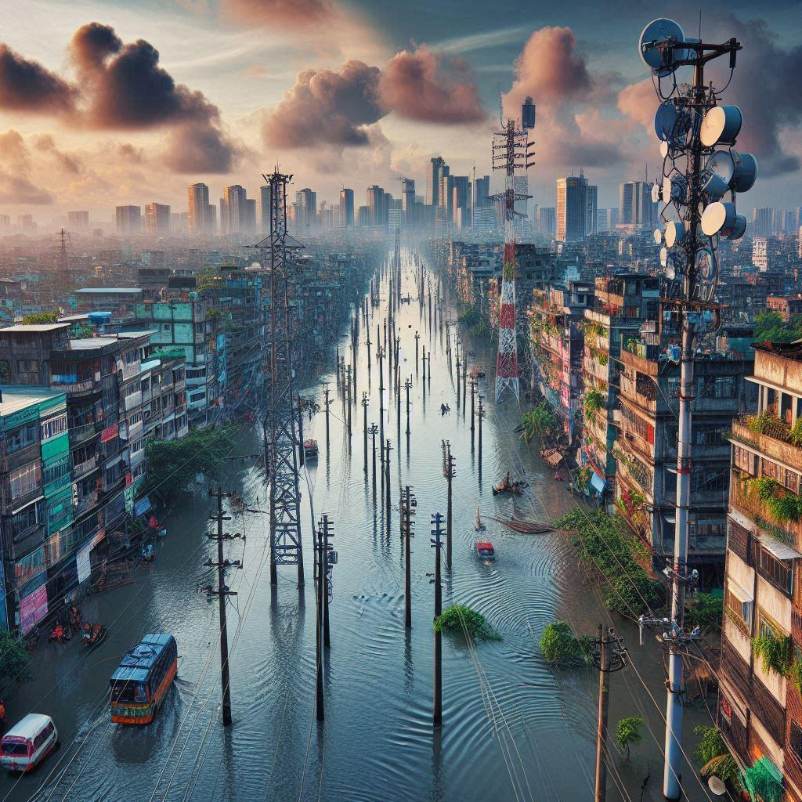
Government’s Loss Due to flood
Bangladesh Government spends around 119,519,600,000.00 bangladeshi taka per year due to flood damage because of :
Delayed Prediction
Unreliable Statistical Data

Slide 11

FINANCIAL PROJECTIONS:
119,519,600.00 Bangladeshi Taka
1,792,794,000.00 Bangladeshi Taka
Year 2
Year 1
Year 3
1,195,196,000.00 Bangladeshi Taka

Slide 12

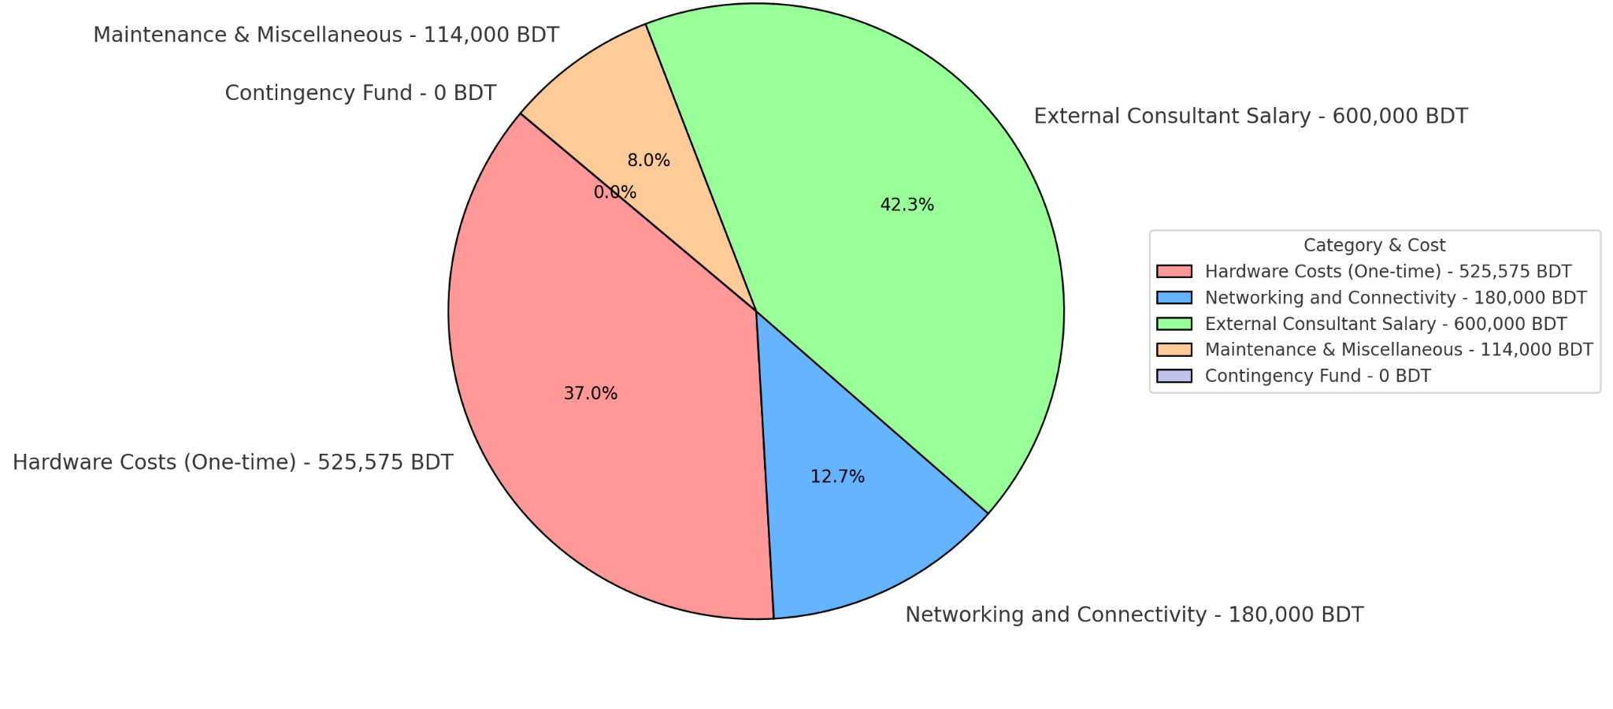
Funding Requirements
Goal: 1,419,575BDT to scale TERRA for deployment and enhancements.

Slide 13
Thank you

Slide 14
Output of the product
Water body monitoring
Sustainable aquaculture
Fish population dynamics
Water body health assessment
Biological productivity
Livestock management
Climatic situation of an area
Pollution assessment
Carbon sink
Utilisation of idle water body
City health monitoring
Influxes
Future research potentialities

Slide 15
Sensor Requirements
Do sensor
Turbidity sensor
Depth sensor
ph sensor
Nitrogen amonia sensor
Temperature sensor
Salinity sensor

Slide 16
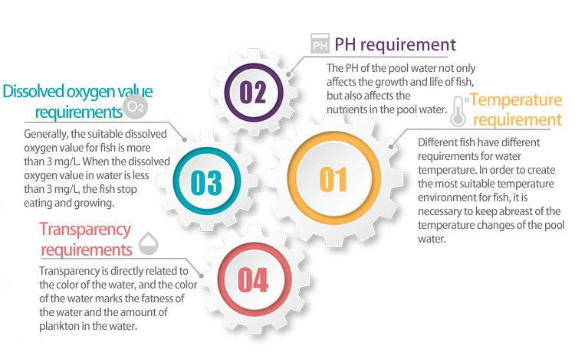
Smart aquaculture Monitoring system

Slide 17
TERRA For Aquaculture and water body monitor

